Slide 1

HOME CREDIT DEFAULT RISK
Presented by: Abhishek Kumar Pandey
A Comprehensive Analysis of Customer Credit Risk Using Multi-Table Financial and Behavioral Data to Identify Default Patterns and Risk Drivers
www.scaletrix.ai

Slide 2

Introduction
Financial institutions face significant challenges in assessing customer creditworthiness before loan approval.
Incorrect risk evaluation can lead to high default rates and financial losses.
The Home Credit Default Risk dataset provides a comprehensive view of customer financial profiles and behavioral history, enabling deeper understanding of default patterns.
This analysis focuses on:
Customer Financial Profile
Credit History Evaluation
Payment Behavior Analysis
Default Risk Identification

Slide 3



Project Objectives
The primary objective of this analysis is to understand and identify key factors influencing customer loan default using multi-table financial data.
Key objectives include:
Analyze customer financial profile and credit exposure
Examine historical credit behavior and loan records
Evaluate repayment patterns and payment delays
Identify key risk drivers contributing to loan default
Prepare dataset for predictive modeling of default risk

Slide 4


Business Problem: Credit Risk in Lending
Financial institutions operate in a highly competitive and risk-sensitive environment where accurate credit risk assessment is critical. When approving loans, banks must balance minimizing default risk while maximizing customer acquisition and revenue.
Approving high-risk applicants can lead to financial losses, whereas rejecting low-risk applicants results in missed opportunities and reduced growth. Traditional credit evaluation methods often fail to capture complex customer behavior and financial patterns.
Key Challenges:
With the availability of large-scale customer data, there is a growing need for data-driven approaches. Analyzing customer demographics, financial information, and credit history enables organizations to improve decision-making and better manage risk.
Identifying high-risk vs low-risk customers
Reducing loan defaults
Avoiding rejection of eligible applicants
Improving decision accuracy using data

Slide 5
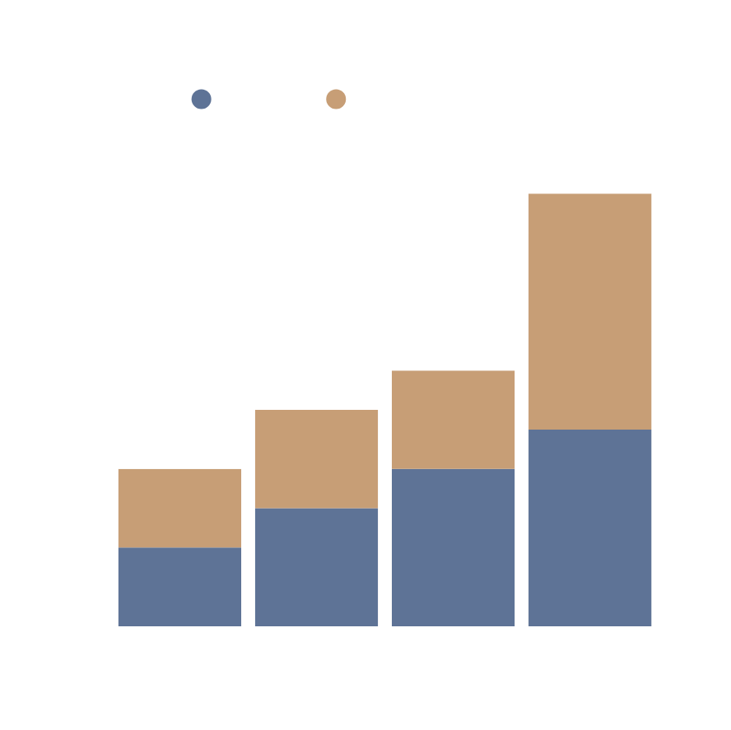
Problem Statement
Financial institutions face significant challenges in accurately assessing the creditworthiness of loan applicants. Incorrect risk evaluation can result in high default rates, financial losses, and inefficient allocation of resources. With the availability of large-scale, multi-table financial data, it becomes essential to derive meaningful insights that support better decision-making.
From an Exploratory Data Analysis (EDA) perspective, the objective is to analyze customer demographics, financial attributes, credit history, and behavioral patterns to identify key factors influencing loan default. This involves understanding relationships, trends, and risk indicators embedded across multiple interconnected tables.
From a Machine Learning (ML) perspective, the goal is to develop a predictive model that can accurately classify whether a customer is likely to default on a loan (TARGET = 1) or not (TARGET = 0). The major challenge lies in transforming complex relational data into meaningful features that enhance both interpretability and predictive performance.

Slide 6
Key Stakeholders in Credit Risk Analysis
Risk Analyst
Data Scientist / Analyst
Business / Loan Manager
Evaluates customer creditworthiness
Identifies high-risk applicants
Monitors default patterns
Makes loan approval decisions
Balances risk and profitability
Uses insights for strategic actions
Performs EDA and feature engineering
Builds predictive models
Generates actionable insights

Slide 7

Data Overview
Understanding the structure, features, and relationships within the dataset

Slide 8
Star Schema
installments_payments
(Repayment Behavior)
bureau
(External Credit History)
APPLICATION_TRAIN
Primary Key: SK_ID_CURR
Target Variable: Default (0/1)
previous_application
(Past Loan Applications)
bureau_balance
(Monthly Credit Status)
credit_card_balance
(Spending Behavior)
POS_CASH_balance
(Short-term Loans)
All auxiliary tables are aggregated at the customer level using SK_ID_CURR and merged into the central application dataset for analysis and modeling.

Slide 9
Multiple Data Sources
(bureau, POS_CASH, credit_card, installments, previous_application)
Dataset Overview
🔷 Main Description
The Home Credit Default Risk dataset is a multi-table financial dataset designed to assess customer credit risk and predict loan default behavior. It contains detailed information about customer demographics, financial profiles, credit history, and repayment behavior.
Feature Engineering & Aggregation
(GroupBy, Merging, Handling Missing Values)
🔷 Key Characteristics:
~300,000+ customer records
7 interconnected relational tables
100+ features across multiple domains
Combination of static and behavioral data
Real-world credit risk modeling problem
Final Dataset
(Customer-Level Data for Analysis & ML)
🔷 Target Variable:
TARGET = 1 → Customer will default
TARGET = 0 → Customer will not default
This dataset enables both exploratory analysis of customer behavior and predictive modeling of credit risk.

Slide 10
Data
Dictionary

Slide 11
APPLICATION DATA
(CENTER TABLE)

Slide 12
Application Data
- (307511, 122)
Feature | Description | Type
SK_ID_CURR | Unique customer identifier | ID
TARGET | Default flag (1 = default, 0 = no default) | Target
AMT_INCOME_TOTAL | Total income of the customer | Numeric
AMT_CREDIT | Loan amount requested | Numeric
AMT_ANNUITY | Loan annuity amount | Numeric
AMT_GOODS_PRICE | Price of goods financed | Numeric
NAME_CONTRACT_TYPE | Type of loan (Cash/ Revolving) | Categorical
CODE_GENDER | Gender of customer | Categorical
FLAG_OWN_CAR | Owns a car (Y/N) | Binary
FLAG_OWN_REALITY | Owns property (Y/N) | Binary
DAYS_BIRTH | Age of customer (in days) | Numeric
DAYS_EMPLOYED | Employment duration (in days) | Numeric
OCCUPATION_TYPE | Type of occupation | Categorical

Slide 13
CREDIT
HISTORY

Slide 14
External Credit History
bureau- (1716428, 17)
Feature | Description | Type
SK_ID_BUREAU | Unique bureau loan ID | ID
SK_ID_CURR | Customer ID | Key
CREDIT_ACTIVE | Status of credit | Categorical
CREDIT_TYPE | Type of credit | Categorical
AMT_CREDIT_SUM | Total credit amount | Numeric
AMT_CREDIT_SUM_DEBT | Outstanding debt | Numeric
DAYS_CREDIT | Days since credit taken | Numeric
DAYS_CREDIT_ENDDATE | Credit end date | Numeric

Slide 15
Monthly Credit Status
bureau_balance-(27299925, 3)
Feature | Description | Type
SK_ID_BUREAU | Unique bureau loan ID | ID
MONTHS_BALANCE | Month of record | Numeric
STATUS | Credit status per month | Categorical
CREDIT_TYPE | Type of credit | Categorical

Slide 16
PREVIOUS
APPLICATIONS

Slide 17
Previous Loans
previous_application- (1670214, 37)
Feature | Description | Type
SK_ID_PREV | Previous loan ID | ID
SK_ID_CURR | Customer ID | Key
NAME_CONTRACT_TYPE | Loan type | Categorical
AMT_APPLICATION | Applied amount | Numeric
AMT_CREDIT | Approved credti amount | Numeric
NAME_CONTRACT_STATUS | Approved/ Rejected | Categorical
RATE_DOWN_PAYMENT | Down payment rate | Categorical

Slide 18
Behavioral
Tables

Slide 19
Behavioral Data
installments_payments- (13605401, 8)
Feature | Description | Type
SK_ID_PREV | Previous loan ID | ID
SK_ID_CURR | Customer ID | Key
AMT_INSTALLMENT | Installment amount | Numeric
DAYS_ENTRY_PAYMENT | Payment date | Numeric
DAYS_INSTALLMENT | Due date | Numeric
AMT_PAYMENT | Payment made | Numeric

Slide 20
Spending Behavior
credit_card_balance- (3840312, 23)
Feature | Description | Type
SK_ID_PREV | Previous loan ID | ID
SK_ID_CURR | Customer ID | Key
AMT_BALANCE | Current balance | Numeric
AMT_CREDIT_LIMIT_ACTUAL | Credit limit | Numeric
AMT_DRAWINGS_CURRENT | Amount spent | Numeric
AMT_PAYMENT_CURRENT | Payment made | Numeric

Slide 21
Short-term Loans
POS_CASH_balance- (10001358, 8)
Feature | Description | Type
SK_ID_PREV | Previous loan ID | ID
SK_ID_CURR | Customer ID | Key
CNT_INSTALLMENT | Total installments | Numeric
CNT_INSTALLMENT_FUTURE | Remaining installments | Numeric
MONTHS_BALANCE | Time index | Numeric
SK_DPD | Days past due | Numeric
These features collectively capture customer financial profile, credit history, and behavioral patterns essential for credit risk modeling.

Slide 22
Potential Analysis & Use Cases
Exploratory Analysis
Predictive Modeling
Analyze customer demographics, financial profiles, and credit history to identify patterns and behavioral trends.
Build machine learning models to predict loan default probability using integrated multi-source data.
Risk Assessment
Evaluate factors influencing loan default such as income, credit behavior, and repayment history.
Feature Engineering
Combine and transform data from multiple tables to create meaningful customer-level features for analysis and modeling.

Slide 23
Why This Dataset is Valuable
Rich Multi-Table Structure
The dataset contains multiple interconnected tables capturing customer demographics, credit history, and behavioral data, enabling comprehensive analysis.
Strong Feature Engineering Potential
The availability of diverse data sources allows creation of powerful customer-level features through aggregation and transformation.
Business Relevance
Addresses real-world financial risk problems faced by lending institutions.

Slide 24

THANK YOU!
Presented by: Abhishek Kumar Pandey
A robust multi-table dataset designed to support advanced feature engineering and real-world credit risk modeling.
www.scaletrix.ai

